Slide 1
Surface-to-volume ratios of space-filling curves on 2:1 balanced adaptive grids
Leith Osborne

Slide 2
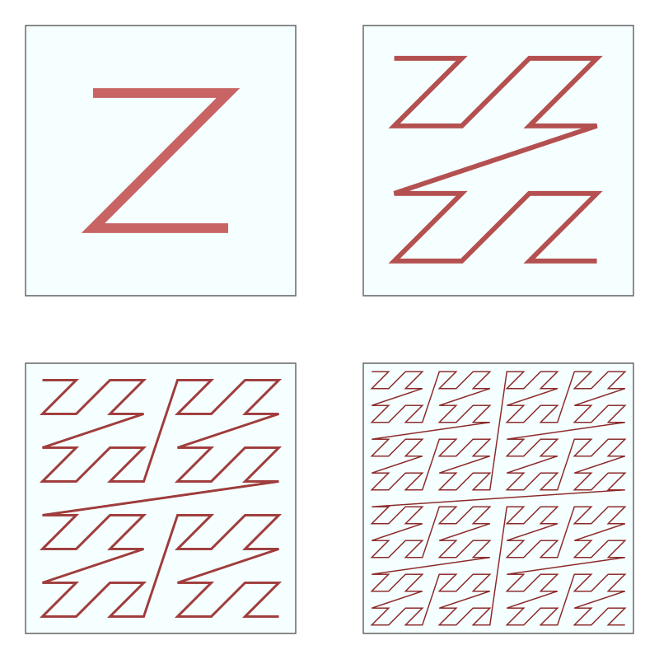
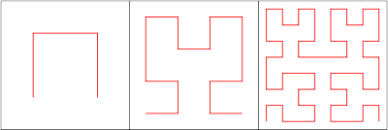
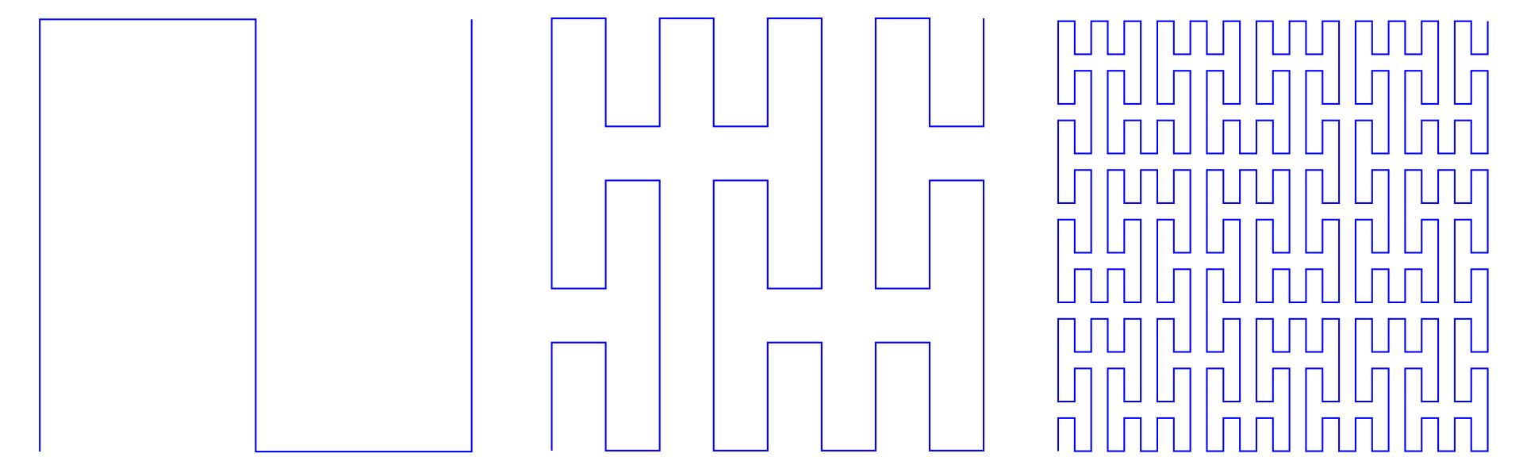
What are space-filling curves?
1
2
3
Z-order Curve
1
2
3
Hilbert Curve
1
2
3
Peano Curve
Notes:
- Curves that fill the space they are in.
- Iterative process.
- Start with basic curve, refine on iteration to the point where curve cover entire range of space. (square)

Slide 3
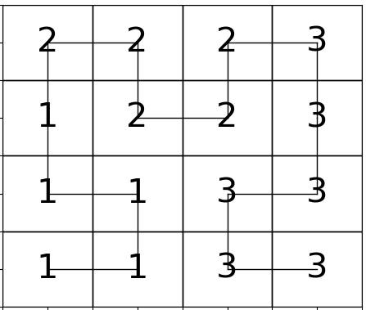
Applications of space-filling curves
Space-filling curves present an effective method of mapping multidimensional data to one dimension in parallel computing.
Surfaces
Volumes
For processors [1, 2, 3]
Notes:
Main applications of space-filling curves is in parallelisation
And the main two criteria for efficient partitioning algorithms in parallel computing:
- Is for partitions to Distribute workload between processors uniformly to reduce the time processors spend idle, waiting for other processors to finish and
- To make the boundaries of partitions as short as possible to reduce inter-processor communication time.
Space-filling curves are known to fulfil both criteria because of locality preserving properties and the quality of partitions can be measured by surface to volume ratio.
Volumes represent blocks of data
Surfaces represent boundaries between data blocks

Slide 4
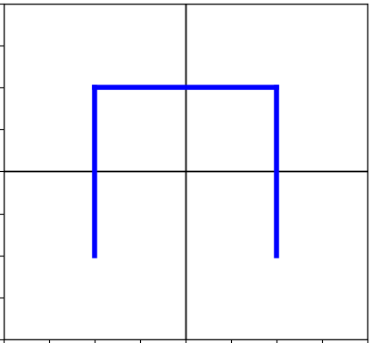
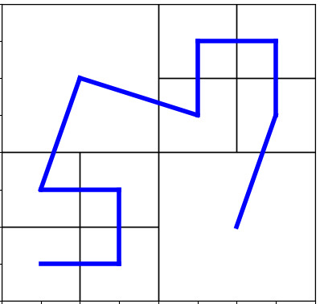
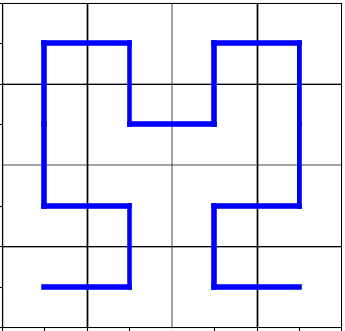
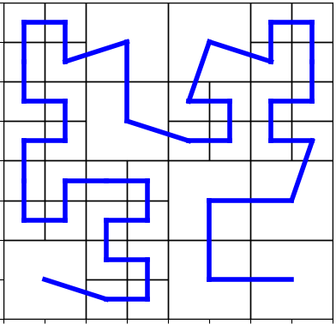
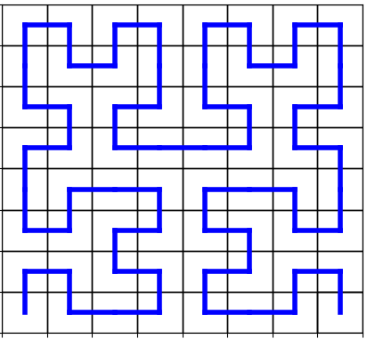
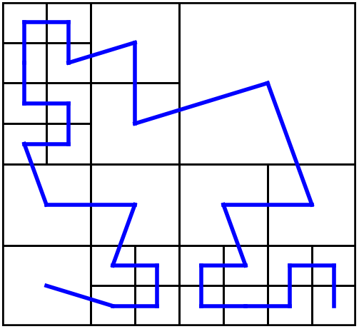
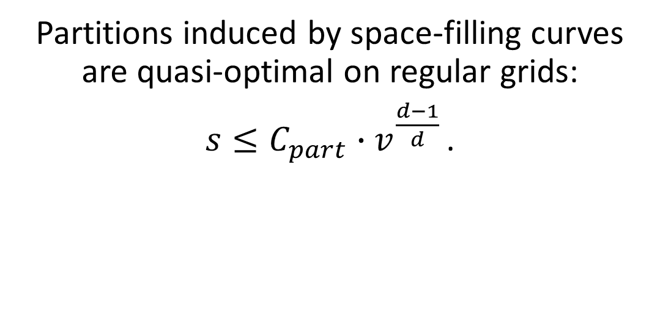
Quality of partitions
Partitions induced by space-filling curves are quasi-optimal on regular grids:
$s≤C_{part}∙v^{\frac{d−1}{d} }$.
(Zumbusch, 2000)
OPTIMAL
Notes:
proven that the Hilbert curve is quasi-optimal on regular grids
Regular grid - Each square in the grid is uniform in size.
Quasi-optimal – surface-to-volume ratios for all partitions have their surfaces bounded by constant times volume
Aim of project is to investigate whether this inequality holds for partitions induced by Hilbert curve on two-dimensional 2:1 balanced adaptive grids.
Adaptive – cells differ in size
2:1 balance – maximum difference in size between two neighbouring cells is 2:1
Tackle this using brute force approach to collect as many surface to volume ratios as possible. See trends in data collected

Slide 5
The Basics

Slide 6
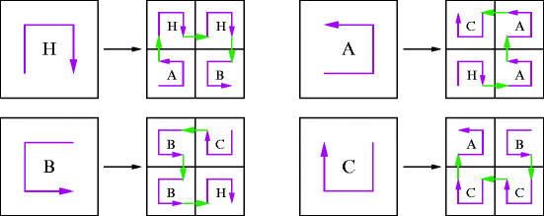
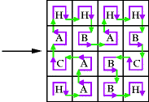
Constructing the Hilbert Curve
Depth = 1
Depth = 2
Depth = 3
H ⟵ A ↑ H → H ↓ B
A ⟵ H → A ↑ A ← C
B ⟵ C → B ↑ B ← H
C ⟵ B → C ↑ C ← A
Notes:
For regular grids follows production rules. Letters are non-terminals, directions terminals.
Apply production rules of H, A H H B, gets you first three grids

Slide 7
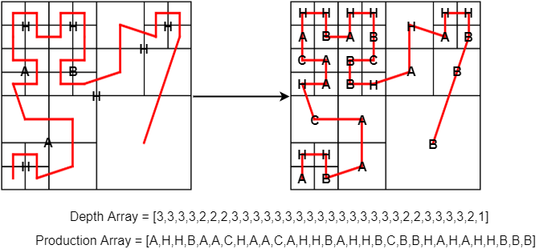
Hilbert curve on adaptive grids
Notes:
Instead of representing a shape, Each non-terminal describes the shape of a cells next refinement. Depth array is used to keep track of depth of each cell. i.e no of times cells has been refined.

Slide 8
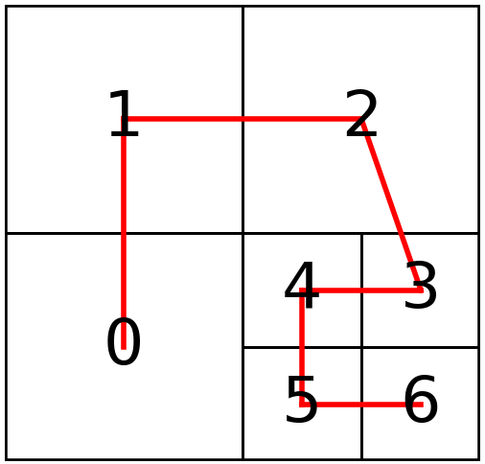
Cell neighbourhood
Store boundaries of each cell in neighbourhood dictionary.
Neighbourhood: {0:[[],[1],[5,4],[]], 1:[[],[],[2],[0]], 2:[[1],[],[],[4,3]], 3:[[4],[2],[],[6]], 4:[[0],[2],[3],[5]], 5:[[0],[4],[6],[]], 6:[[5],[3],[],[]]}
Notes:
As we are interested in the boundaries of each cell when computing surface to volume ratios, store all neighbours inside dictionary. Values split into 4 lists depending on boundary we are looking at.

Slide 9
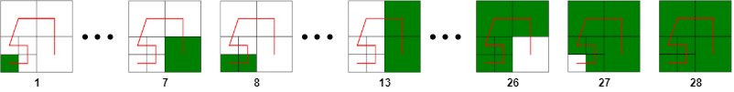
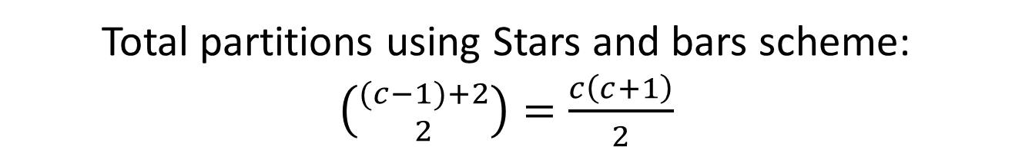
Surface-to-volume ratio of partitions
Represent c cells by c adjacent stars.
Insert two bars to determine the volume v of the partition and the position of the partition x₁ , x₂ within the grid.
x₁ + v + x₂ = c; v >= 1
Total partitions using Stars and bars scheme:
$\left({(c−1)+2 \atop 2}\right)=\frac{c\left(c+1\right)}{2}$
Notes:
To compute sv ratio for all grid structures,
- Set two loops start pos and size

Slide 10
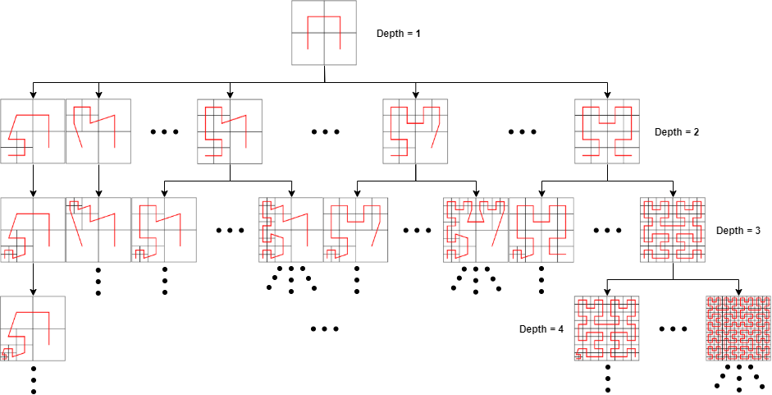
The search space
Notes:
-modelled as a tree-like structure
-traverse breadth first
Can compute ratios on a depth level basis
As we can see, the number of partition opportunies explode per depth level

Slide 11
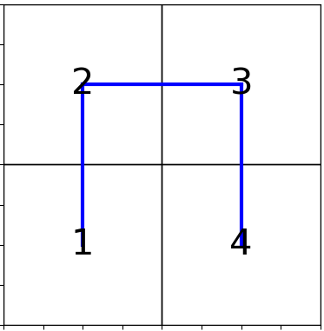
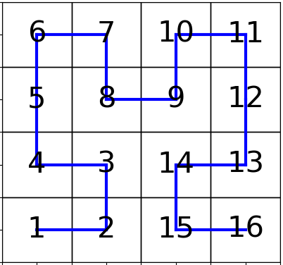
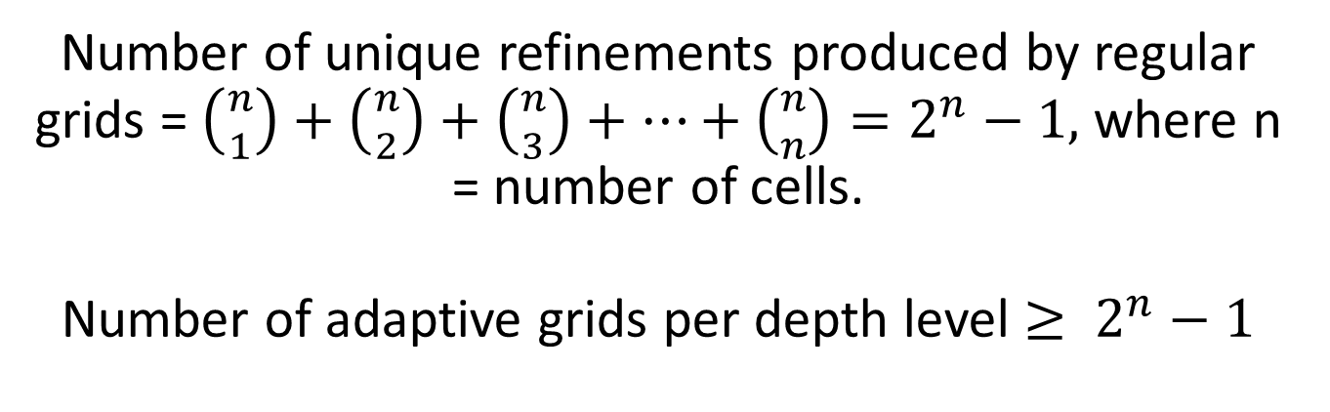
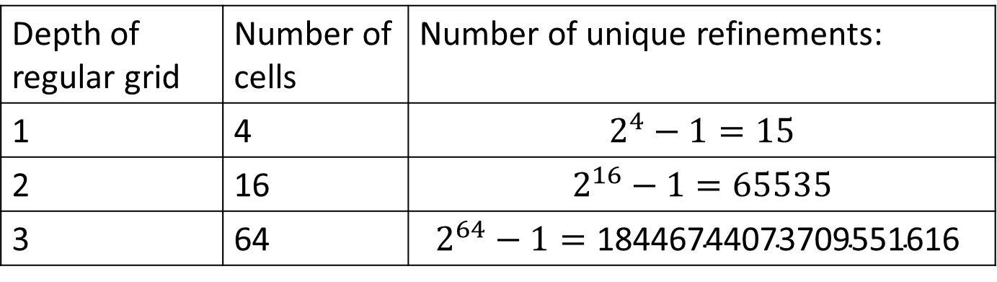
Refinements per grid
Number of unique refinements produced by regular grids = $\left({n \atop 1}\right)+\left({n \atop 2}\right)+\left({n \atop 3}\right)+…+\left({n \atop n}\right)=2^{n}−1,$ where n = number of cells.
Number of adaptive grids per depth level $≥ 2^{n}−1$
Depth of regular grid | Number of cells | Number of unique refinements:
1 | 4 | $$2^{4}−1=15$$
2 | 16 | $$2^{16}−1=65535$$
3 | 64 | $$2^{64}−1=\text{18446744073709551616 }$$
.
.
.
Notes:
In fact ,The number of adaptive grids that can be produced from the refinement of a regular grid alone is 2^n, where n is the number of cells within the grid structure.

Slide 12
Exploiting properties of space-filling curves

Slide 13
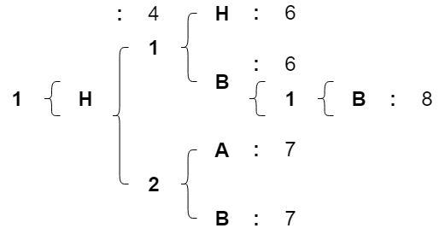
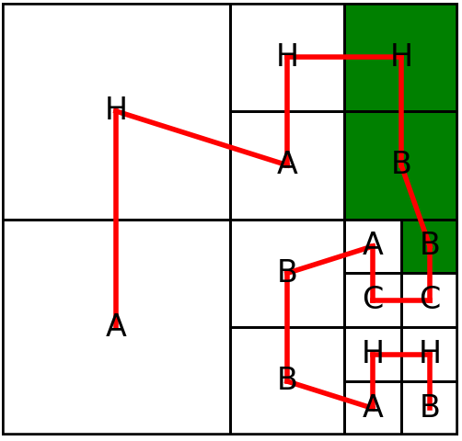
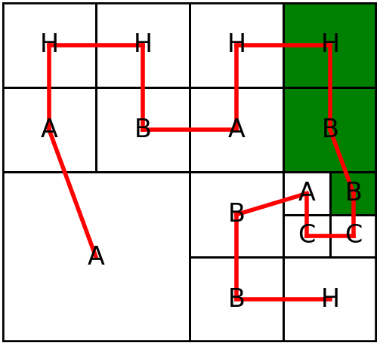
Pattern Dictionary
Grid A
Grid B
[2 → H → 2 → B → 3 → B]
[2 → H → 2 → B → 3→ B]
Notes:
Whenever we find surface-to-volume ratio add surface length to pattern dictionary
And before brute force, check if pattern in pattern dictionary
Look at grid a, describe by depth → non-terminal → depth…
Add pattern to pattern dictionary
Look at grid b, check pattern dictionary
No need to compute s

Slide 14
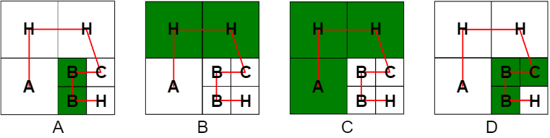
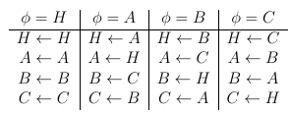
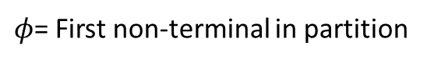
Similarities between partitions
D = [2 → C → 2 →B → 2 → B]
$φ$= First non-terminal in partition
D’ = [1 → H → 1 → A → 1 → A] = C’
Notes:
In many cases, same partition, different depths and non-terminals
i.e. grid a and b, grids c and d
Before searching pattern dict, substitute and upscale pattern
D’= c’ only need to compute one of these

Slide 15
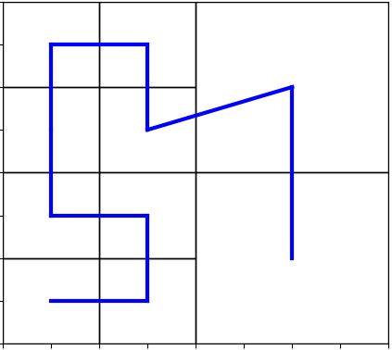
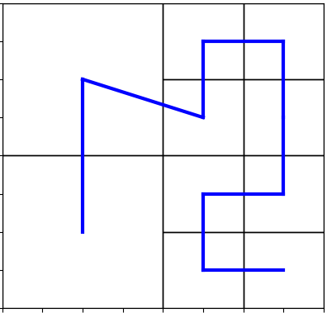
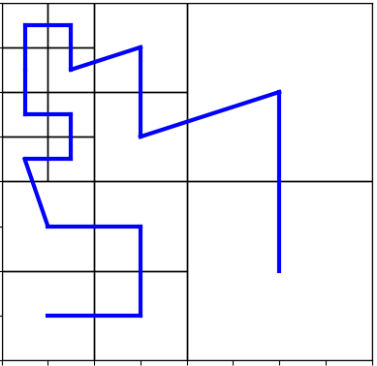
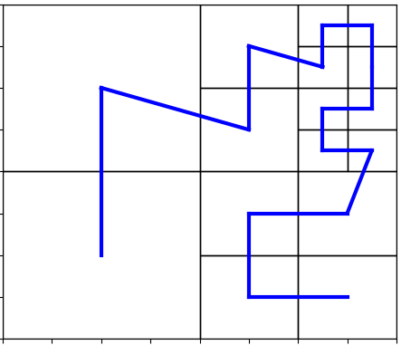
Reflective properties
Curve E
Curve A
Curve B
Curve C
Curve D
Cap maximum refinements to the left of the central vertical line to the number of refinements to the right and iterate up to the symmetrical refinement
All non-symmetric grids share identical surface-to-volume ratios with a different grid in the search space.
Notes:
Reflective properties
Some cases entire grids output identical surface-to-volume ratios
i.e curves a an b, curves b,d.
this means brute force algorithm does not need to traverse a and c and results can be computed from b and d
This achieved by capping maximum of refinements to the left by the number of refinements made on the right for symmetric grids.

Slide 16
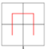
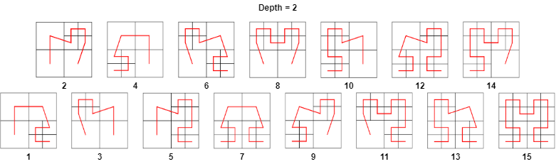
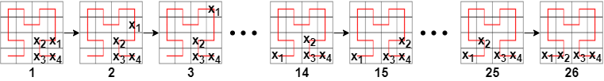
Capping refinements on symmetric grids
Order of iteration for n = 16, r = 4

Slide 17
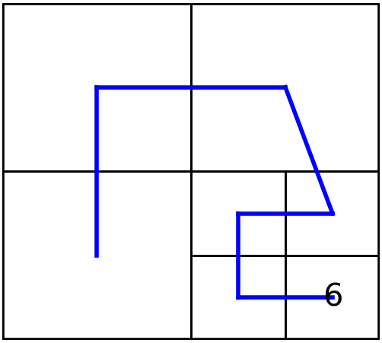
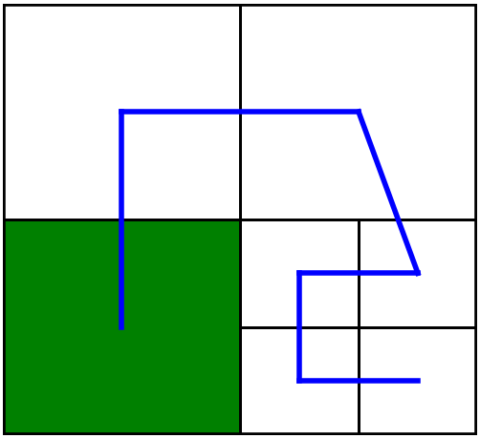
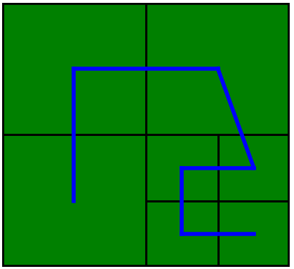
Final Implementation
Clone previous curve
Curve
Id = 1 Production_list = [a,h,h,b] Depth_list = [1,1,1,1] Neighbours = {0:[[],[1],[3],[]],1:[[],[],[2],[0]],2:[[1],[],[],[3]],3:[[0],[2],[],[]]} Refinement_loc = [3] Midpoint = 2 Duplicates = 2
Curve
Production_list = [a,h,h,c,b,b,h] Depth_list = [1,1,1,2,2,2,2]
Update neighbourhood and midpoint
Apply
Production
rules
Curve
Neighbourhood = {0:[[],[1],[5,4],[]], 1:[[],[],[2],[0]], 2:[[1],[],[],[4,3]], 3:[[4],[2],[],[6]], 4:[[0],[2],[3],[5]], 5:[[0],[4],[6],[]], 6:[[5],[3],[],[]]} Midpoint = 2
Find refinable
locations
Find and calculate surface-to-volume ratios for all partitions in grid
Curve
Future_left_refinements = [] Future_right_refinements = [6]

Slide 18
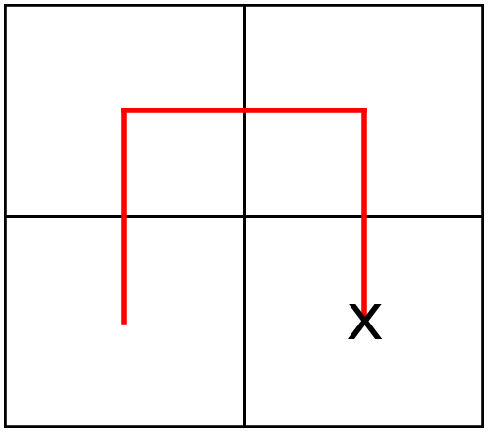
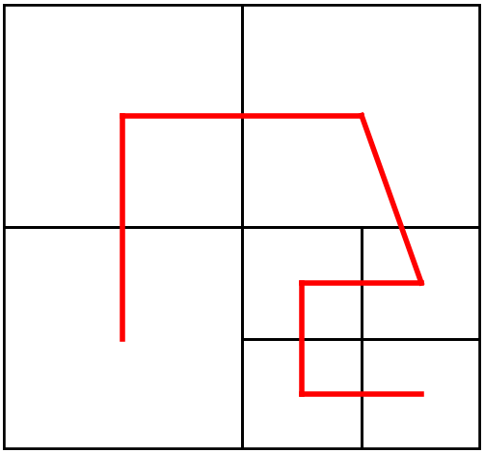
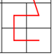
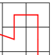
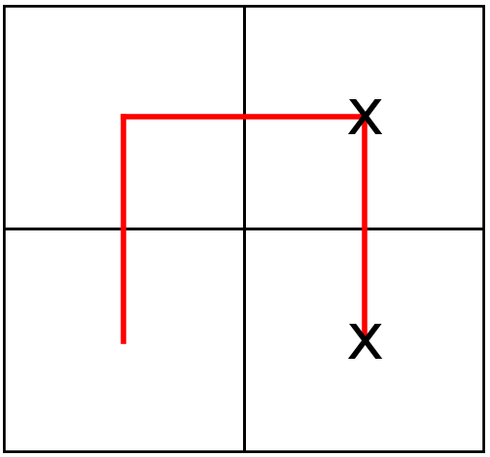
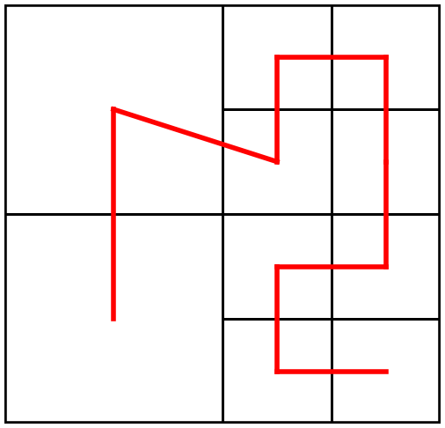
Finding the cell neighbourhood
Inherit Cell
Neighbourhood
Use non-terminal to determine order of traversal
2
1
B
r = 1
3
4
3
3
B
Find boundaries amongst refined cells
Connect to grid
3
H
r = 2
4
3
B
Notes:
Find out neighbours of each cell from the shape of the non-terminal
Consider two shapes if connecting two refined cells

Slide 19
Results

Slide 20
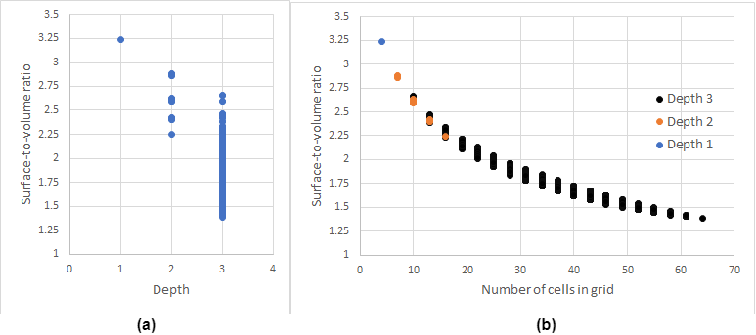
Averages per depth level
Notes:
Grids become more complex – quality of partitions improves
- Infers bounded

Slide 21
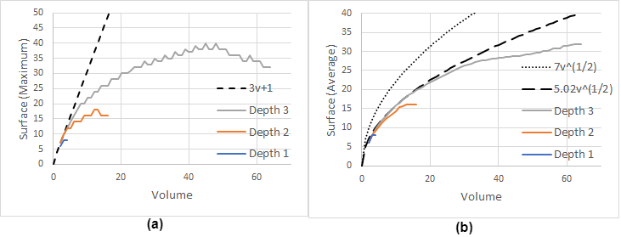
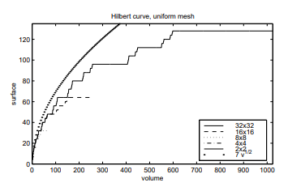
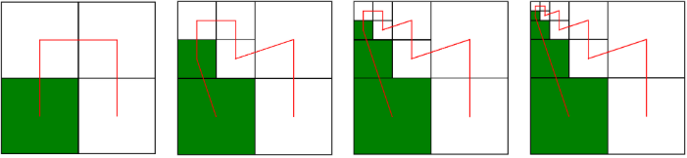
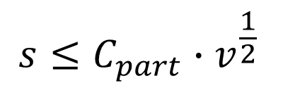
Surface-to-volume ratio
$$s≤C_{part}∙v^{\frac{1}{2} }$$
Zumbusch (Maximum) S:V for regular grids
Maximum

